Slide 1
LECTURE # 12
TREE

Slide 2
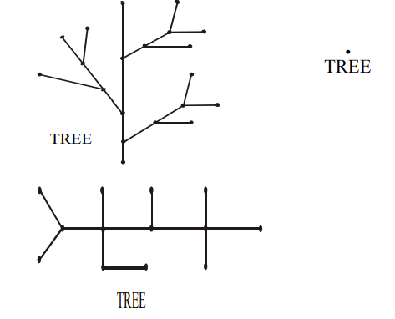
TREES APPLICATION AREAS:
Trees are used to solve problems in a wide variety of disciplines. In computer science trees are employed to
construct efficient algorithms for locating items in a list.
construct networks with the least expensive set of telephone lines linking distributed computers.
construct efficient codes for storing and transmitting data.
model procedures that are carried out using a sequence of decisions, which are valuable in the study of sorting algorithms.
TREE:
A tree is a connected graph that does not contain any non-trivial circuit. (i.e. it is circuit free).
A trivial circuit is one that consists of a single vertex.
Examples of tree are

Slide 3
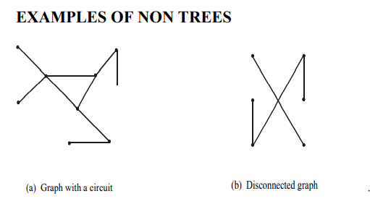
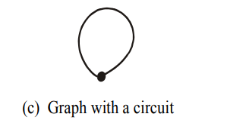
there exists circuit, so not a tree
there exists no connectedness, so not a tree.
there exists a circuit (also due to loop), so not a tree (because trees have to be a circuit free).

Slide 4
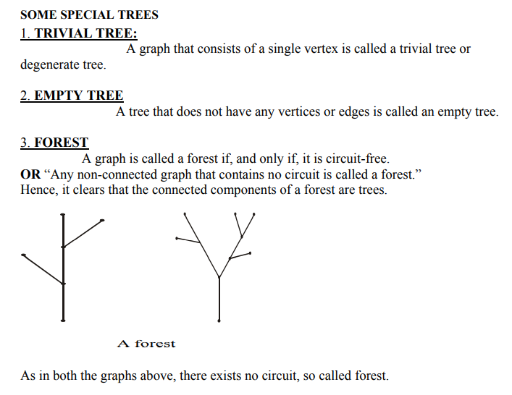

Slide 5
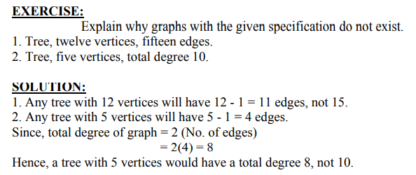
PROPERTIES OF TREES:
Theorem 7.2.3
If T is a graph with n vertices, the following are equivalent:
a) T is a tree
b) T is connected and acyclic
(“acyclic” = having no cycles)
c) T is connected and has n-1 edges
d) T is acyclic and has n-1 edges
Practice question

Slide 6
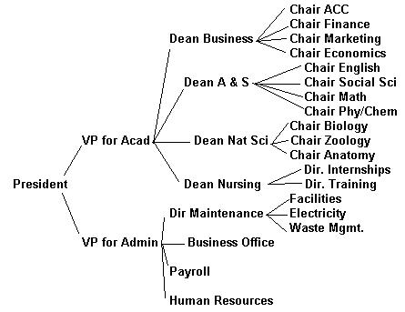
Example : Tree Organizational charts

Slide 7
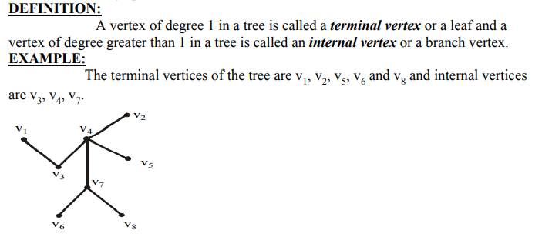

Slide 8
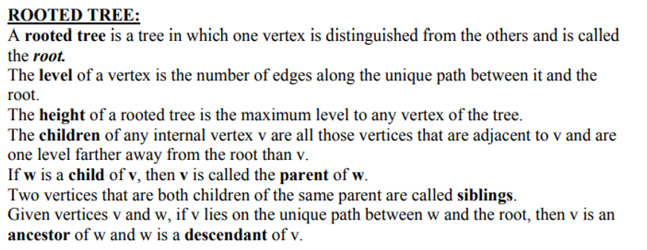
A node's "uncles" are siblings of that node's parent.
A node that is connected to all lower-level nodes is called an "ancestor". The connected lower-level nodes are "descendants" of the ancestor node.

Slide 9
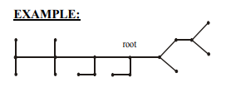
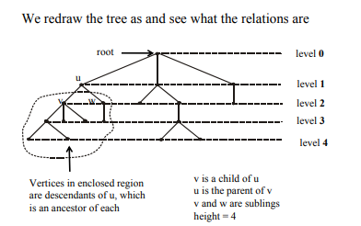
Practice question

Slide 10
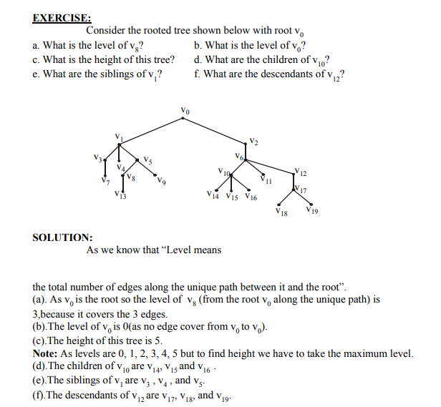
Practice question

Slide 11
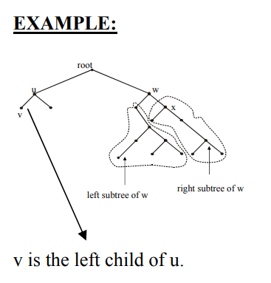
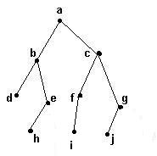
Binary trees
A binary tree is a tree where each vertex has zero, one or two children

Slide 12
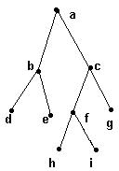
Full binary tree
A full binary tree is a binary tree in which each vertex has two or no children.

Slide 13
Full binary tree
Practice question
Theorem 7.5.4: If T is a full binary tree with k internal vertices, then
T has k + 1 terminal vertices and
the total number of vertices is 2k + 1.
Example:
there are k = 4 internal vertices (a, b, c and f) and 5 terminal vertices (d, e, g, h and i) for a
total of 9 vertices.
2(4) + 1.

Slide 14
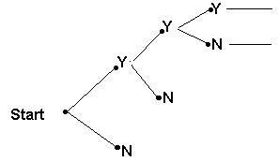
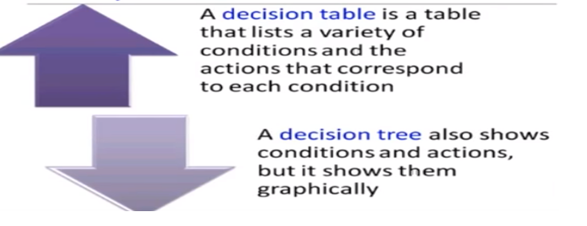
Decision trees
A decision tree is a binary tree containing an algorithm to decide which course of action to take.

Slide 15
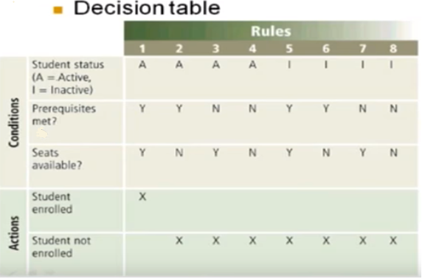
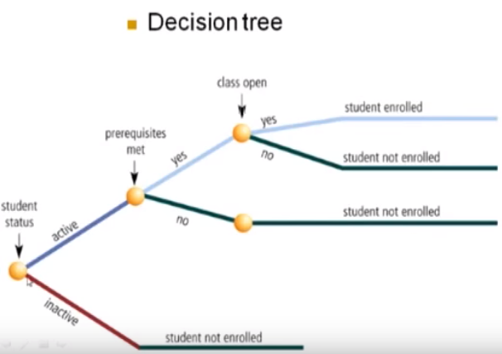
Practice question

Slide 16
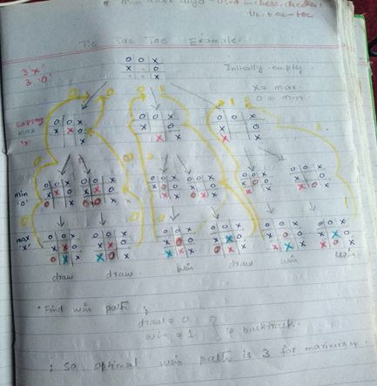

Slide 17
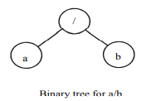
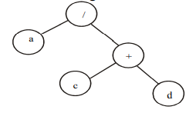
REPRESENTATION OF ALGEBRAIC EXPRESSIONS BY BINARY TREES
Binary trees are specially used in computer science to represent algebraic expression with Arbitrary nesting of balanced parentheses.
The above figure represents the expression a/b. Here the operator (/) is the root and b are the left and right children.
The above figure represents the expression a/(c+d).Here the operator (/) is the root.
Here the terminal vertices are variables (here a, c and d), and the internal vertices are arithmetic operators (+ and /).

Slide 18
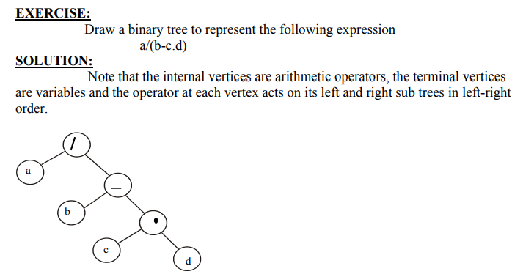

Slide 19
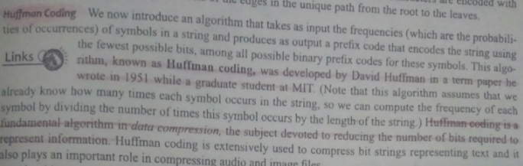

Slide 20

